Slide 1

Ingeniería de soluciones con AI
Docente:
Francisco Macaya
Semestre 2026-1

Slide 2

Noticias: Magnifica Humanitas, reacción del Papa sobre la AI.
Nota: https://www.thearticle.com/magnifica-humanitas-ai-and-the-pope

Slide 3
¿Cuál es la diferencia entre la inteligencia artificial que uso en visual studio code o el chatGPT y el código de mi agente de la evaluación 2?
REPASO

Slide 4
¿Qué es un sistema multi-agente?
REPASO
https://github.com/Foco22/INGENIERIA-DE-SOLUCIONES-CON-INTELIGENCIA-ARTIFICIAL_002D_OLS/tree/main/Experiencia%20de%20Aprendizaje%202%20-%20Desarrollo%20de%20Agente%20Inteligentes%20con%20AI/Clase%202.3

Slide 5
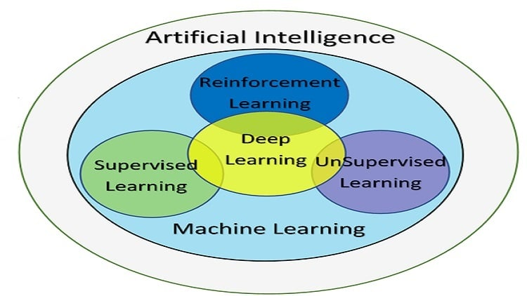
¿Cuál es la diferencia entre AI y ML?
REPASO
Artificial intelligence (AI) is technology that enables computers and machines to simulate human learning, comprehension, problem solving, decision making, creativity and autonomy
https://www.ibm.com/think/topics/artificial-intelligence

Slide 6
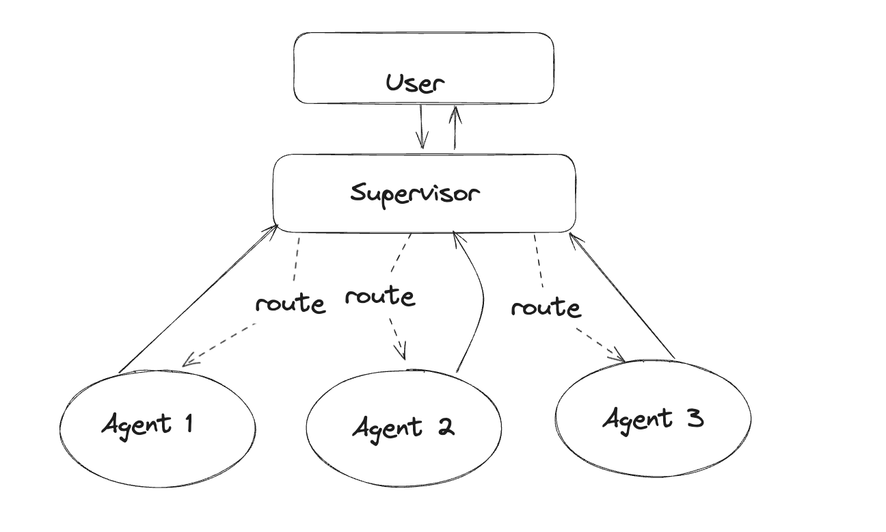
¿Cuál arquitectura es más escalable?
Plan B
Plan A
REPASO
El agente supervisor decide a qué nodo dirigirse en función de las palabras proporcionadas por el usuario. Por ejemplo, si el usuario utiliza términos como "comprar", "compras", "comprarías" o similares, el supervisor selecciona el Agente A.
El agente supervisor invoca a un LLM, que en base a un prompt de sistema, y una instrucción clara, decide a que agente debe llamar en cada momento.

Slide 7
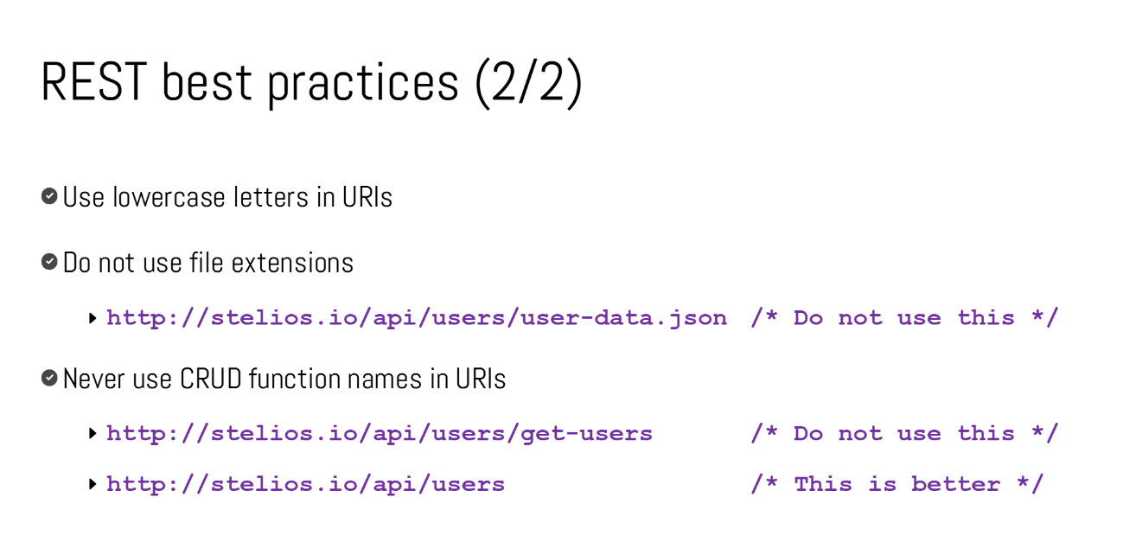
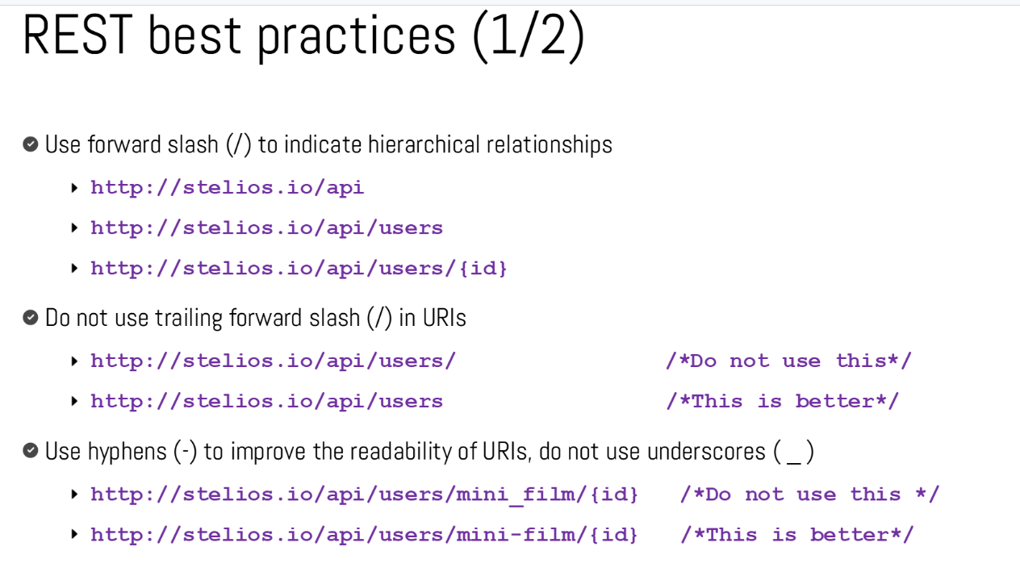
¿Cómo se escribe un endpoint (API) correctamente?
REPASO

Slide 8
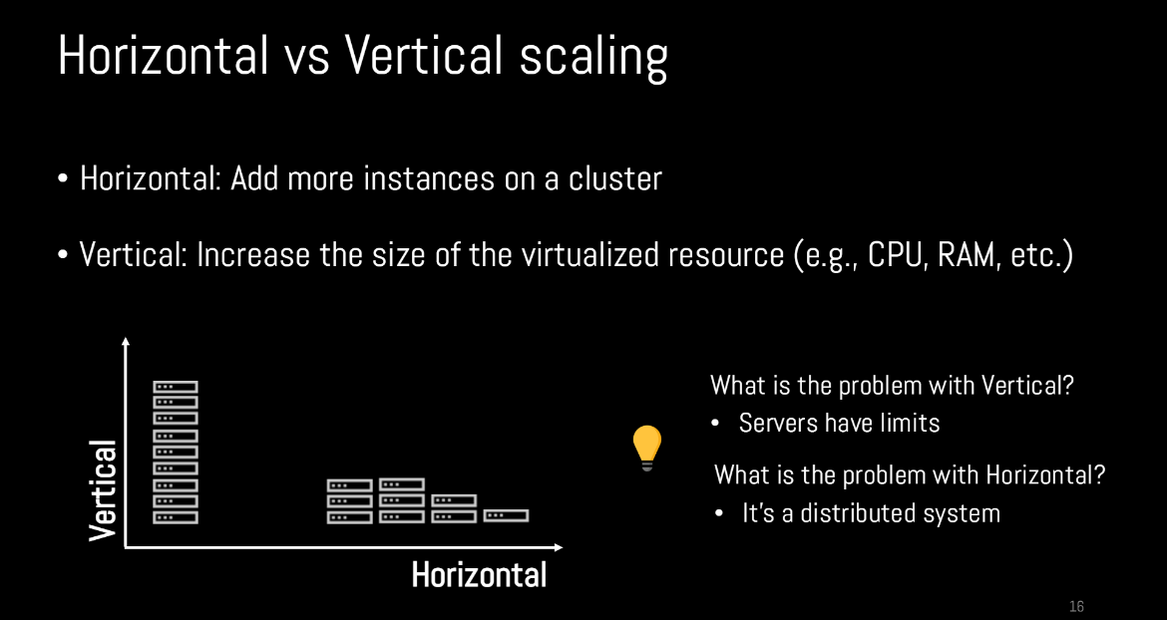
Escalabilidad de un sistema: Mas maquinas o mas potencia.

Slide 9

Ejemplos: Un start-up, con pocos usuarios, suele ser monolito.

Slide 10
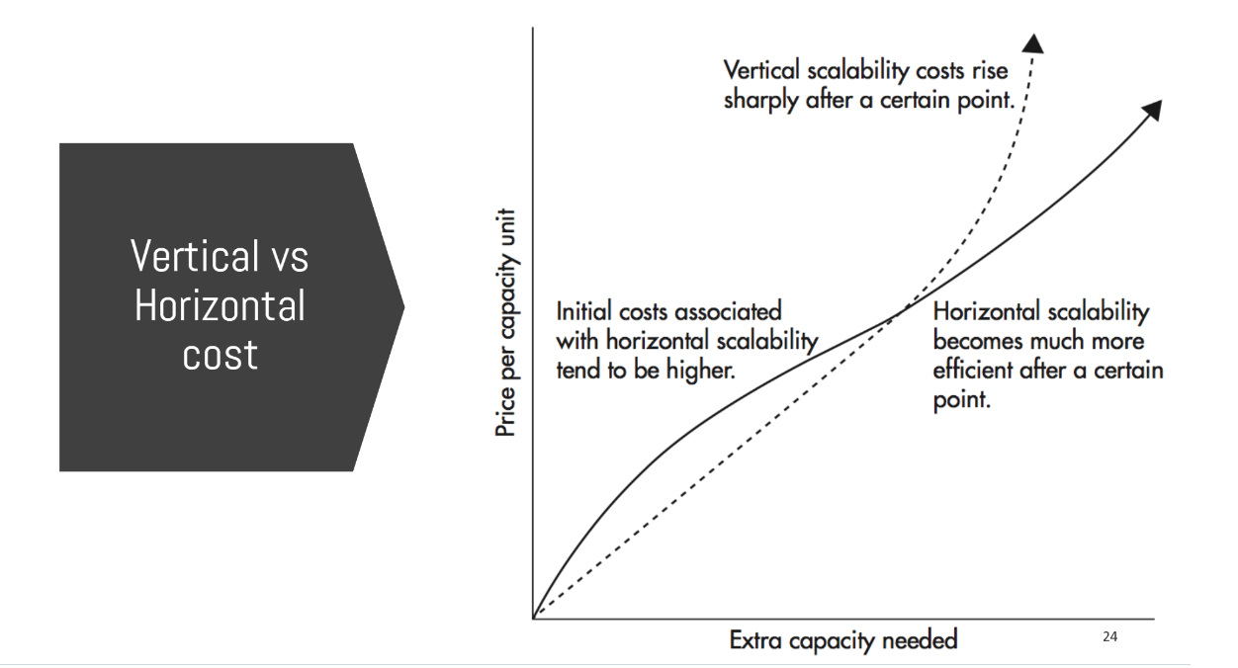
¿Cuánto moverse?: Suele ser una decisión económica.

Slide 11
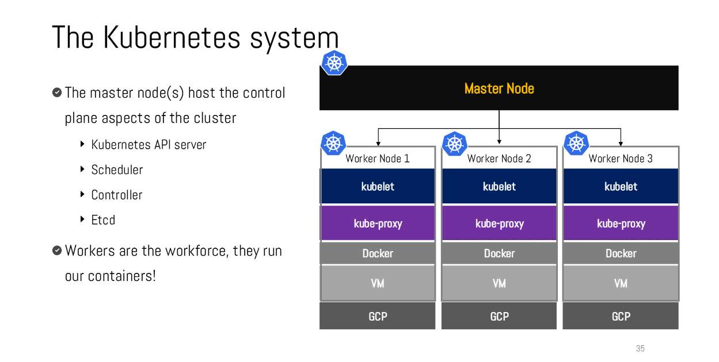
Kubernetes: La solución escalable que soluciona cualquier tipo de problema de conexión entre VMs.
Este ramo no es sobre Kubernetes. No es complicado configurarlo, ya que hoy en día, con GCP, es bastante fácil montar estos servicios, el problema es el costos, y que aplica solo a empresas que tienen un flujo de información alta, no a pequeñas empresas.

Slide 12
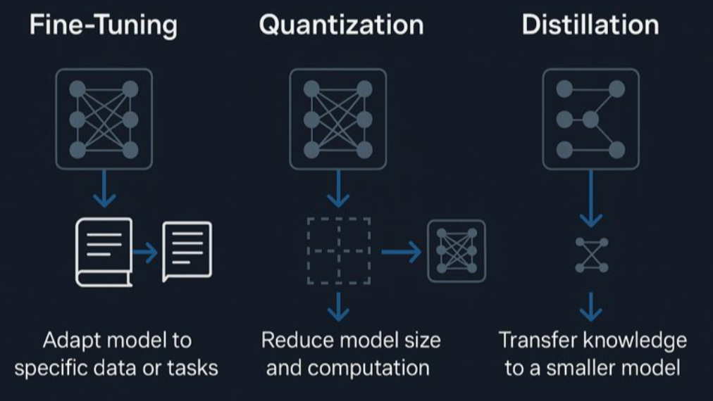
Optimización por modelamiento: Hazlo más pequeño.
Nota: https://www.linkedin.com/pulse/fine-tuning-quantization-distillation-three-very-ways-alvin-kabwama-i47zc/.
Notes:
Model distillation suggests that it’s possible to capture a large model’s behaviors using fewer parameters. Could it be that within the large model, there exists a subset of parameters capable of capturing the entire model’s behavior? This is the core concept behind pruning.
Pruning, in the context of neural networks, has two meanings. One is to remove entire nodes of a neural network, which means changing its architecture and reducing its number of parameters. Another is to find parameters least useful to predictions and set them to zero. In this case, pruning doesn’t reduce the total number of parameters, only the number of non-zero parameters. This makes the model more sparse, which both reduces the model’s storage space and speeds up computation.
Pruned models can be used as-is or be further finetuned to adjust the remaining parameters and restore any performance degradation caused by the pruning process. Pruning can help discover promising model architectures (Liu et al., 2018). These pruned architectures, smaller than the pre-pruned architectures, can also be trained from scratch (Zhu et al., 2017).
In the literature, there have been many encouraging pruning results. For example, Frankle and Carbin (2019) showed that pruning techniques can reduce the non-zero parameter counts of certain trained networks by over 90%, decreasing memory footprints and improving speed without compromising accuracy. However, in practice, as of this writing, pruning is less common. It’s harder to do, as it requires an understanding of the original model’s architecture, and the performance boost it can bring is often much less than that of other approaches. Pruning also results in sparse models, and not all hardware architectures are designed to take advantage of the resulting sparsity.
Weight-only quantization is by far the most popular approach since it’s easy to use, works out of the box for many models, and is extremely effective. Reducing a model’s precision from 32 bits to 16 bits reduces its memory footprint by half. However, we’re close to the limit of quantization—we can’t go lower than 1 bit per value. Distillation is also common because it can result in a smaller model whose behavior is comparative to that of a much larger one for your needs.

Slide 13
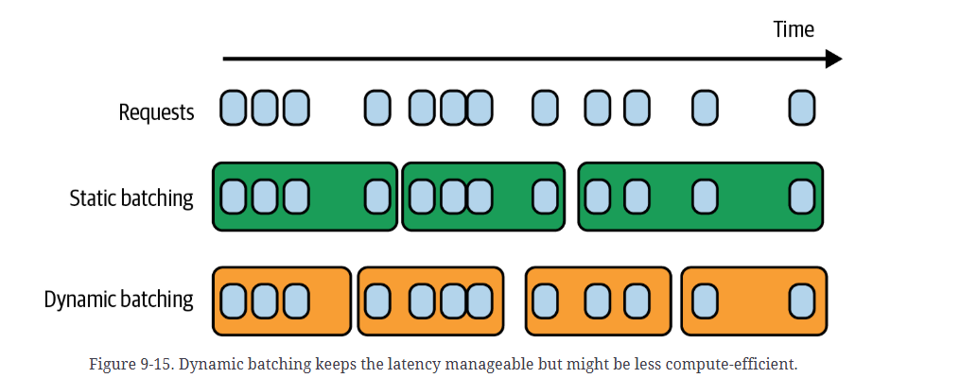
Optimización por inferencia de servicio: GPU más eficiente.
Requests esperan como en un Bus en Static batching, y en Dynamic batching, esperan como en un bus, o hasta un cierto tiempo.
Notes:
Model distillation suggests that it’s possible to capture a large model’s behaviors using fewer parameters. Could it be that within the large model, there exists a subset of parameters capable of capturing the entire model’s behavior? This is the core concept behind pruning.
Pruning, in the context of neural networks, has two meanings. One is to remove entire nodes of a neural network, which means changing its architecture and reducing its number of parameters. Another is to find parameters least useful to predictions and set them to zero. In this case, pruning doesn’t reduce the total number of parameters, only the number of non-zero parameters. This makes the model more sparse, which both reduces the model’s storage space and speeds up computation.
Pruned models can be used as-is or be further finetuned to adjust the remaining parameters and restore any performance degradation caused by the pruning process. Pruning can help discover promising model architectures (Liu et al., 2018). These pruned architectures, smaller than the pre-pruned architectures, can also be trained from scratch (Zhu et al., 2017).
In the literature, there have been many encouraging pruning results. For example, Frankle and Carbin (2019) showed that pruning techniques can reduce the non-zero parameter counts of certain trained networks by over 90%, decreasing memory footprints and improving speed without compromising accuracy. However, in practice, as of this writing, pruning is less common. It’s harder to do, as it requires an understanding of the original model’s architecture, and the performance boost it can bring is often much less than that of other approaches. Pruning also results in sparse models, and not all hardware architectures are designed to take advantage of the resulting sparsity.
Weight-only quantization is by far the most popular approach since it’s easy to use, works out of the box for many models, and is extremely effective. Reducing a model’s precision from 32 bits to 16 bits reduces its memory footprint by half. However, we’re close to the limit of quantization—we can’t go lower than 1 bit per value. Distillation is also common because it can result in a smaller model whose behavior is comparative to that of a much larger one for your needs.

Slide 14
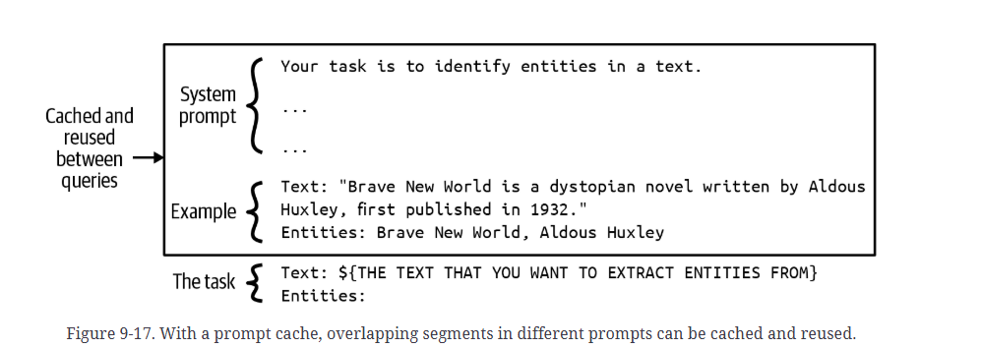
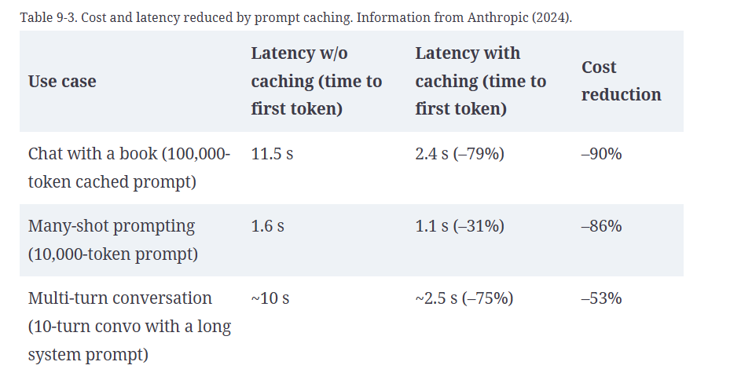
Prompt caching: No te repitas a ti mismo.
Prompt caching esta disponible por los proveedores de APIs de LLMs, y es una buena forma de optimizar costos.
Notes:
Model distillation suggests that it’s possible to capture a large model’s behaviors using fewer parameters. Could it be that within the large model, there exists a subset of parameters capable of capturing the entire model’s behavior? This is the core concept behind pruning.
Pruning, in the context of neural networks, has two meanings. One is to remove entire nodes of a neural network, which means changing its architecture and reducing its number of parameters. Another is to find parameters least useful to predictions and set them to zero. In this case, pruning doesn’t reduce the total number of parameters, only the number of non-zero parameters. This makes the model more sparse, which both reduces the model’s storage space and speeds up computation.
Pruned models can be used as-is or be further finetuned to adjust the remaining parameters and restore any performance degradation caused by the pruning process. Pruning can help discover promising model architectures (Liu et al., 2018). These pruned architectures, smaller than the pre-pruned architectures, can also be trained from scratch (Zhu et al., 2017).
In the literature, there have been many encouraging pruning results. For example, Frankle and Carbin (2019) showed that pruning techniques can reduce the non-zero parameter counts of certain trained networks by over 90%, decreasing memory footprints and improving speed without compromising accuracy. However, in practice, as of this writing, pruning is less common. It’s harder to do, as it requires an understanding of the original model’s architecture, and the performance boost it can bring is often much less than that of other approaches. Pruning also results in sparse models, and not all hardware architectures are designed to take advantage of the resulting sparsity.
Weight-only quantization is by far the most popular approach since it’s easy to use, works out of the box for many models, and is extremely effective. Reducing a model’s precision from 32 bits to 16 bits reduces its memory footprint by half. However, we’re close to the limit of quantization—we can’t go lower than 1 bit per value. Distillation is also common because it can result in a smaller model whose behavior is comparative to that of a much larger one for your needs.

Slide 15
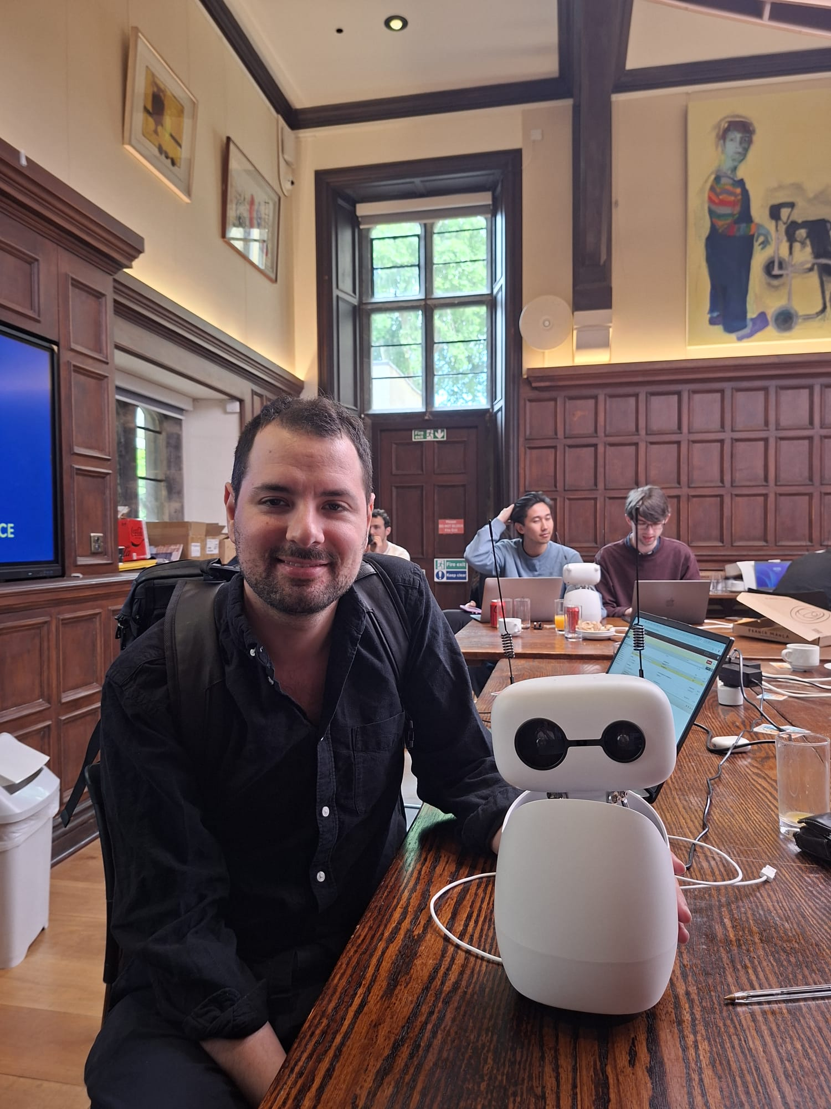
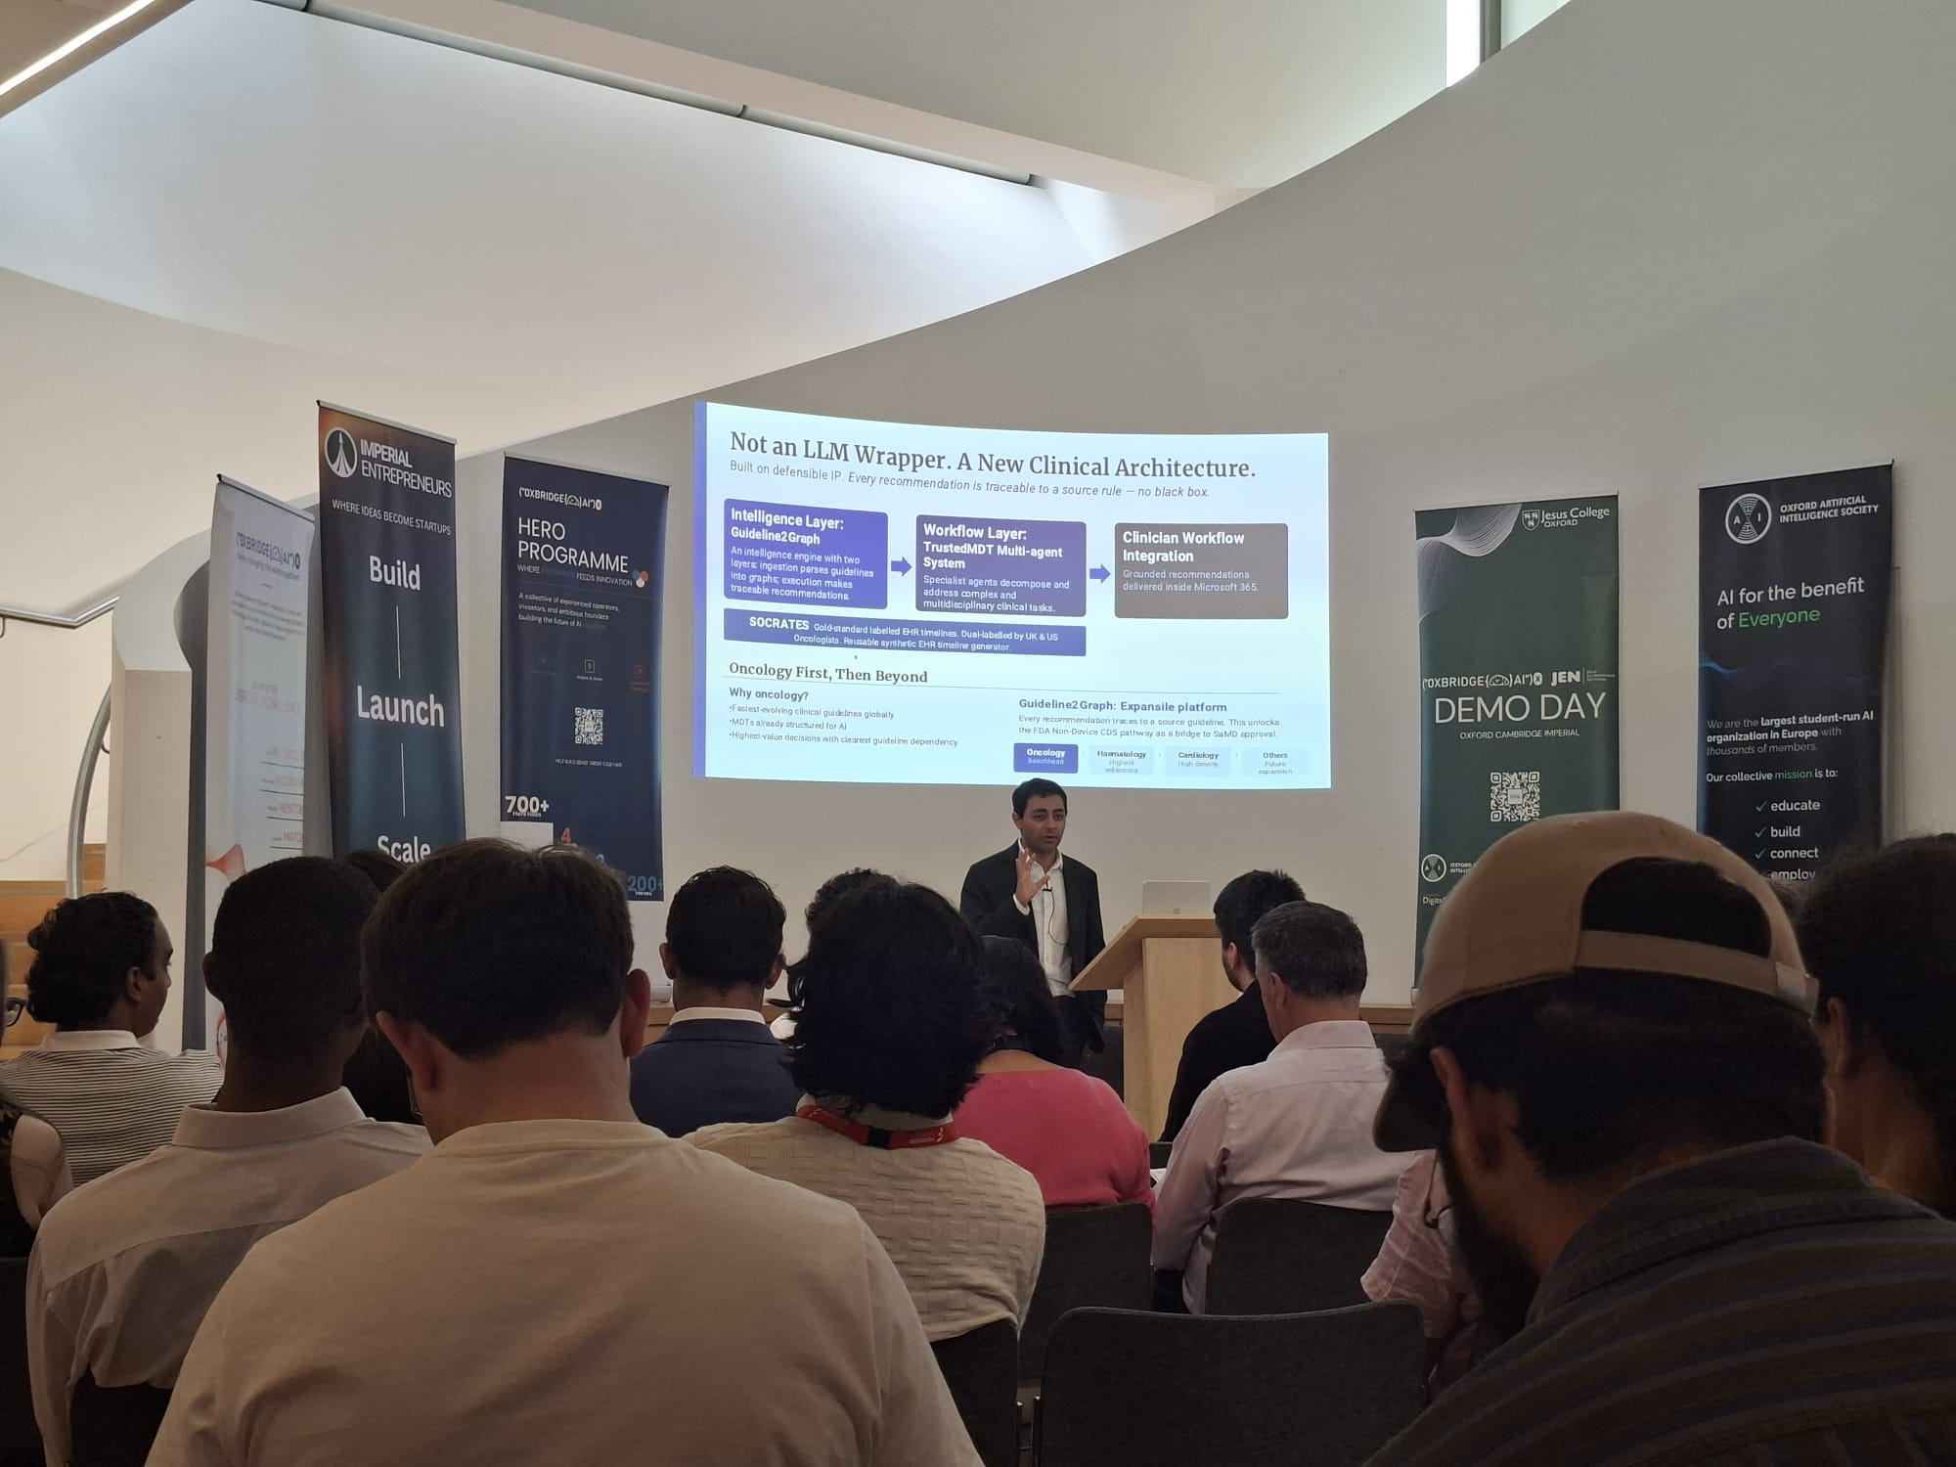
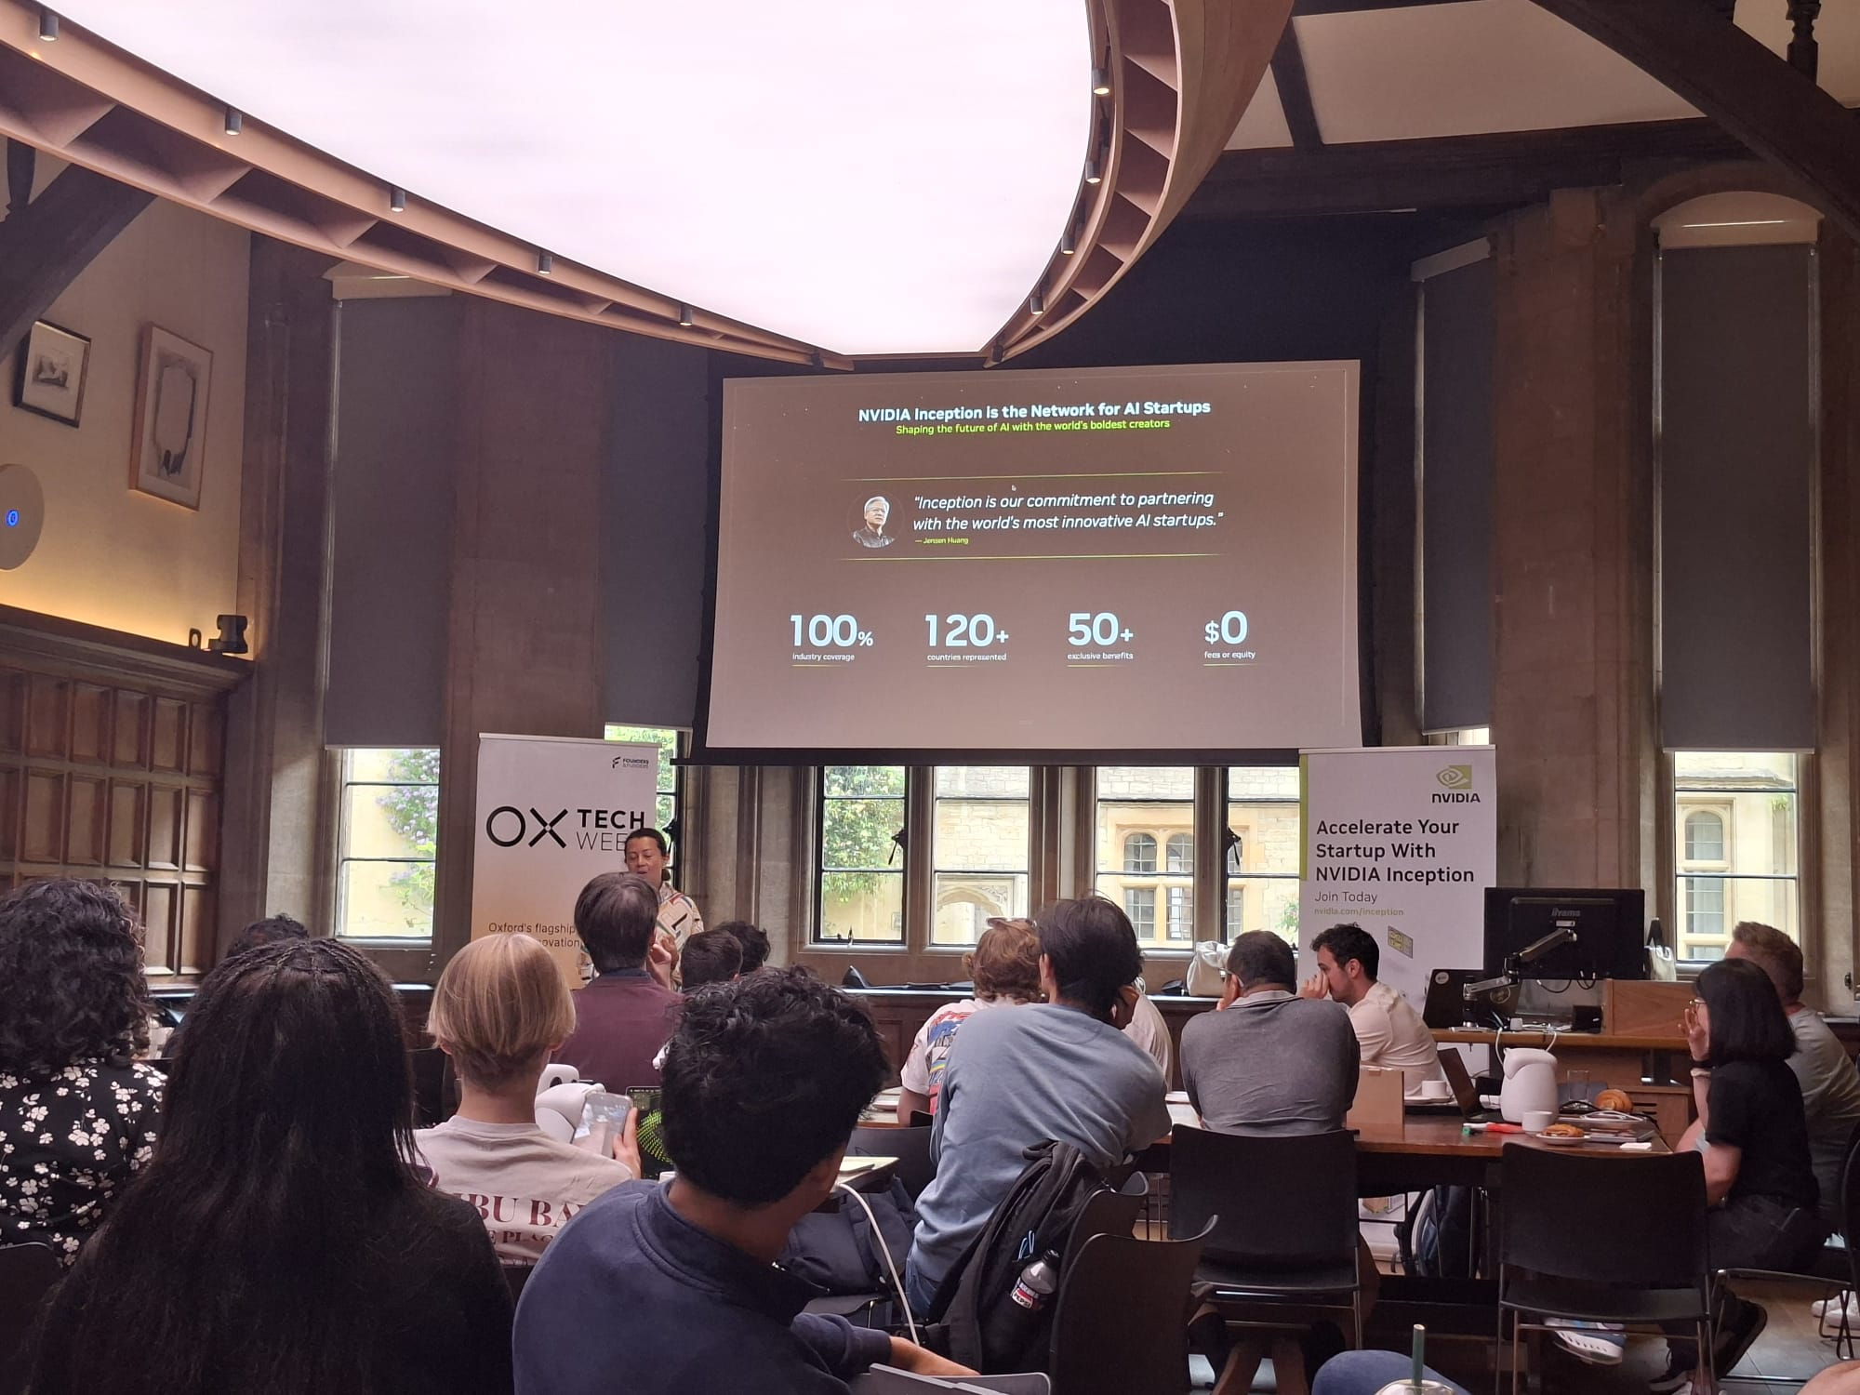
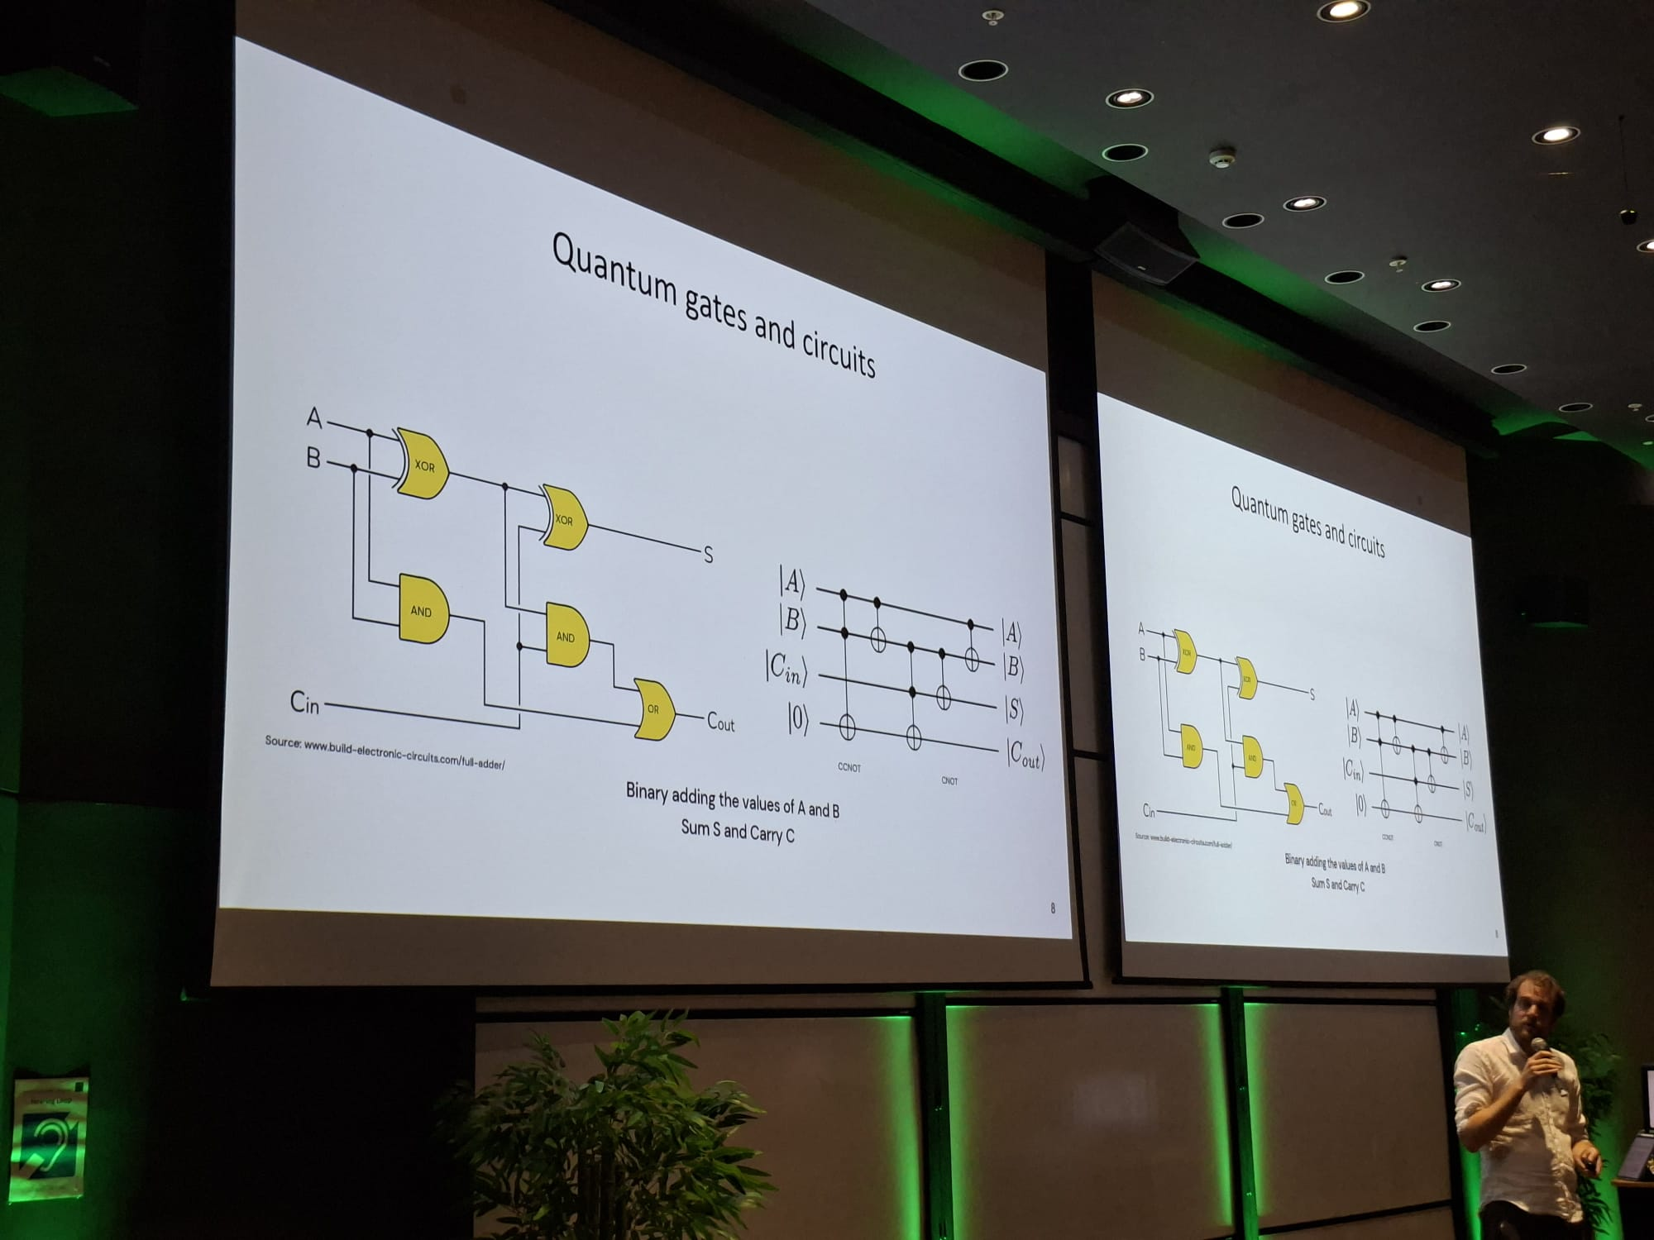
Oxford Tech Week: Agentes, Iot y personas.
Notes:
Model distillation suggests that it’s possible to capture a large model’s behaviors using fewer parameters. Could it be that within the large model, there exists a subset of parameters capable of capturing the entire model’s behavior? This is the core concept behind pruning.
Pruning, in the context of neural networks, has two meanings. One is to remove entire nodes of a neural network, which means changing its architecture and reducing its number of parameters. Another is to find parameters least useful to predictions and set them to zero. In this case, pruning doesn’t reduce the total number of parameters, only the number of non-zero parameters. This makes the model more sparse, which both reduces the model’s storage space and speeds up computation.
Pruned models can be used as-is or be further finetuned to adjust the remaining parameters and restore any performance degradation caused by the pruning process. Pruning can help discover promising model architectures (Liu et al., 2018). These pruned architectures, smaller than the pre-pruned architectures, can also be trained from scratch (Zhu et al., 2017).
In the literature, there have been many encouraging pruning results. For example, Frankle and Carbin (2019) showed that pruning techniques can reduce the non-zero parameter counts of certain trained networks by over 90%, decreasing memory footprints and improving speed without compromising accuracy. However, in practice, as of this writing, pruning is less common. It’s harder to do, as it requires an understanding of the original model’s architecture, and the performance boost it can bring is often much less than that of other approaches. Pruning also results in sparse models, and not all hardware architectures are designed to take advantage of the resulting sparsity.
Weight-only quantization is by far the most popular approach since it’s easy to use, works out of the box for many models, and is extremely effective. Reducing a model’s precision from 32 bits to 16 bits reduces its memory footprint by half. However, we’re close to the limit of quantization—we can’t go lower than 1 bit per value. Distillation is also common because it can result in a smaller model whose behavior is comparative to that of a much larger one for your needs.

